Slide 1


Noida Institute of Engineering and Technology, Greater Noida
Design Pattern
Unit: II
Creational Design Pattern
Ibrar Ahmed
(Asst. Professor)
CSE Department
Course Details (B. Tech. 5th Sem)

Slide 2

Faculty Introduction
Name | Ibrar Ahmed
Qualification | M. Tech. (Computer Engineering)
Designation | Assistant Professor
Department | Computer Science & Engineering
Total Experience | 4 years
NIET Experience | 1 years
Subject Taught | Design & Analysis of Algorithm, Data Structures, Artificial Intelligence, Soft Computing, C Programming, Web Technology, Discrete Mathematics.

Slide 3
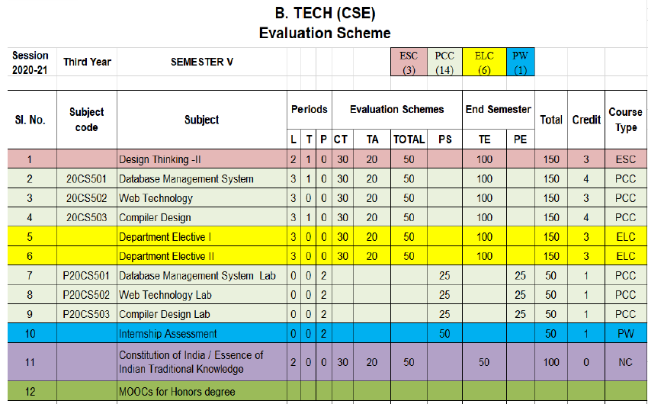
Evaluation Scheme
Python Web development with Django
Design Pattern

Slide 4
Syllabus
UNIT-I: Introduction of Design Pattern
Describing Design Patterns, Design Patterns in Smalltalk MVC, The Catalogue of Design Patterns, Organizing The Cato log, How Design Patterns solve, Design Problems, How to Select a Design pattern, How to Use a Design Pattern. Principle of least knowledge.

Slide 5
Syllabus
UNIT-II: Creational Design Pattern
A Case Study: Designing a Document Editor
Creational Patterns: Abstract Factory, Builder , Factory Method, Prototype , Singleton Pattern,

Slide 6
Syllabus
UNIT-III: Structural Design Pattern
Structural Pattern Part-I, Adapter, Bridge, Composite.
Structural Pattern Part-II, Decorator, Facade, Flyweight, Proxy.

Slide 7
Syllabus
UNIT-IV: Behavioral Design Patterns Part: I
Behavioral Patterns Part: I, Chain of Responsibility, Command, Interpreter, Iterator Pattern.
Behavioral Patterns Part: II, Mediator, Memento, Observer, Patterns.

Slide 8
Syllabus
UNIT-V: Behavioral Design Patterns Part: II
Behavioral Patterns Part: III, State, Strategy, Template Method, Visitor, What to Expect from Design Patterns.

Slide 9
Branch Wise Application
1. Real time web analytics
2. Digital Advertising
3. E-Commerce
4. Publishing
5. Massively Multiplayer Online Games
6. Backend Services and Messaging
7. Project Management & Collaboration
8. Real time Monitoring Services
9.Live Charting and Graphing
10. Group and Private Chat

Slide 10
Course Objective
In this semester, the students will
Study how to shows relationships and interactions between classes or objects..
Study to speed up the development process by providing well-tested, proven development/design paradigms.
Select a specific design pattern for the solution of a given design problem.
Create a catalogue entry for a simple design pattern whose purpose and application is understood.

Slide 11
Course Outcomes (COs)
At the end of course, the student will be able to:
CO1 : Construct a design consisting of collection of modules.
CO2 : Exploit well known design pattern such as Factory, visitor etc.
CO3 : Distinguish between different categories of design patterns.
CO4 : Ability to common design pattern for incremental development.
CO5 : Identify appropriate design pattern for a given problem and design the software using pattern oriented architecture.

Slide 12
Program Outcomes (POs)
Engineering Graduates will be able to:
PO1 : Engineering Knowledge
PO2 : Problem Analysis
PO3 : Design/Development of solutions
PO4 : Conduct Investigations of complex problems
PO5 : Modern tool usage
PO6 : The engineer and society

Slide 13
Program Outcomes (POs)
Engineering Graduates will be able to:
PO7 : Environment and sustainability
PO8 : Ethics
PO9 : Individual and teamwork
PO10 : Communication
PO11 : Project management and finance
PO12 : Life-long learning

Slide 14

COs - POs Mapping
CO.K | PO1 | PO2 | PO3 | PO4 | PO5 | PO6 | PO7 | PO8 | PO9 | PO10 | PO11 | PO12
CO1 | 2 | 2 | 2 | 3 | 3 | - | - | - | - | - | - | -
CO2 | 3 | 2 | 3 | 2 | 3 | - | - | - | - | - | - | -
CO3 | 3 | 2 | 3 | 2 | 3 | - | - | - | - | - | - | -
CO4 | 3 | 2 | 3 | 2 | 3 | - | - | - | - | - | - | -
CO5 | 3 | 2 | 3 | 3 | 3 | - | - | - | - | - | - | -
AVG | 2.8 | 2.0 | 2.8 | 2.4 | 3.0 | - | - | - | - | - | - | -

Slide 15
Program Specific Outcomes(PSOs)
S. No. | Program Specific Outcomes (PSO) | PSO Description
1 | PSO1 | Understand to shows relationships and interactions between classes or objects of a pattern.
2 | PSO2 | Study to speed up the development process by providing well-tested, proven development
3 | PSO3 | Select a specific design pattern for the solution of a given design problem
4 | PSO4 | Create a catalogue entry for a simple design pattern whose purpose and application is understood.

Slide 16
COs - PSOs Mapping
CO.K | PSO1 | PSO2 | PSO3 | PSO4
CO1 | 3 | - | - | -
CO2 | 3 | 3 | - | -
CO3 | 3 | 3 | - | -
CO4 | 3 | 3 | - | -
CO5 | 3 | 3 | - | -

Slide 17
Program Educational Objectives (PEOs)
Program Educational Objectives (PEOs) | PEOs Description
PEOs | To have an excellent scientific and engineering breadth so as to comprehend, analyze, design and provide sustainable solutions for real-life problems using state-of-the-art technologies.
PEOs | To have a successful career in industries, to pursue higher studies or to support entrepreneurial endeavors and to face the global challenges.
PEOs | To have an effective communication skills, professional attitude, ethical values and a desire to learn specific knowledge in emerging trends, technologies for research, innovation and product development and contribution to society.
PEOs | To have life-long learning for up-skilling and re-skilling for successful professional career as engineer, scientist, entrepreneur and bureaucrat for betterment of society.

Slide 18
Result Analysis(Department Result & Subject Result & Individual result
Name of the faculty | Subject code | Result % of clear passed
Mr. Sanjay Nayak

Slide 19
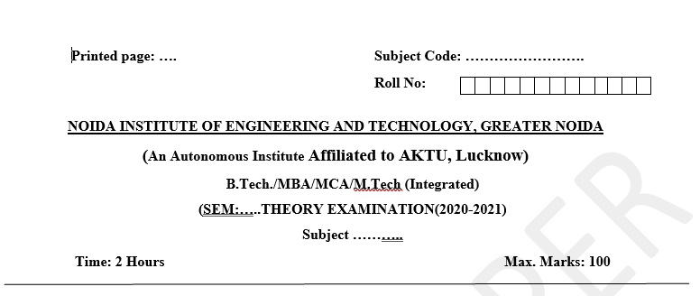
Pattern of Online External Exam Question Paper (100 marks)

Slide 20
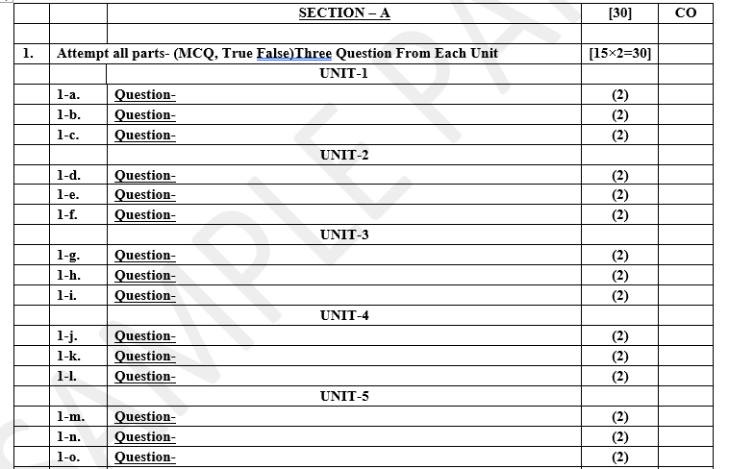
Pattern of Online External Exam Question Paper (100 marks)

Slide 21
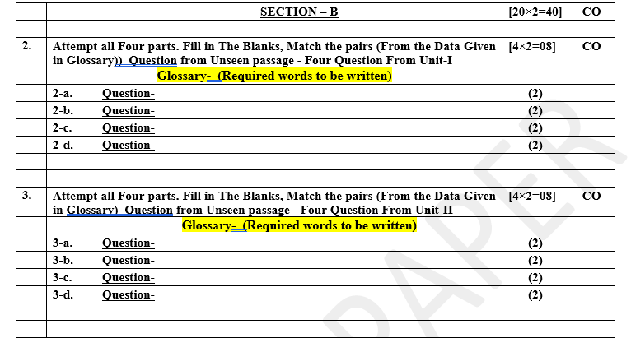
Pattern of Online External Exam Question Paper (100 marks)

Slide 22
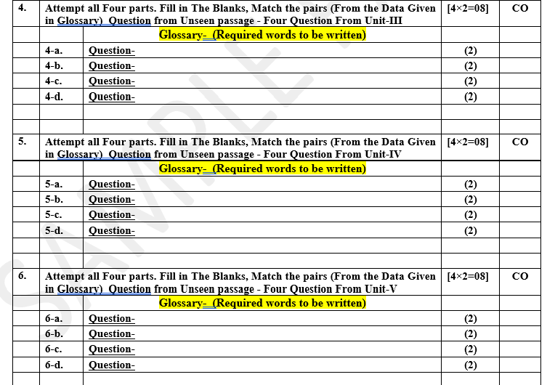
Pattern of Online External Exam Question Paper (100 marks)

Slide 23
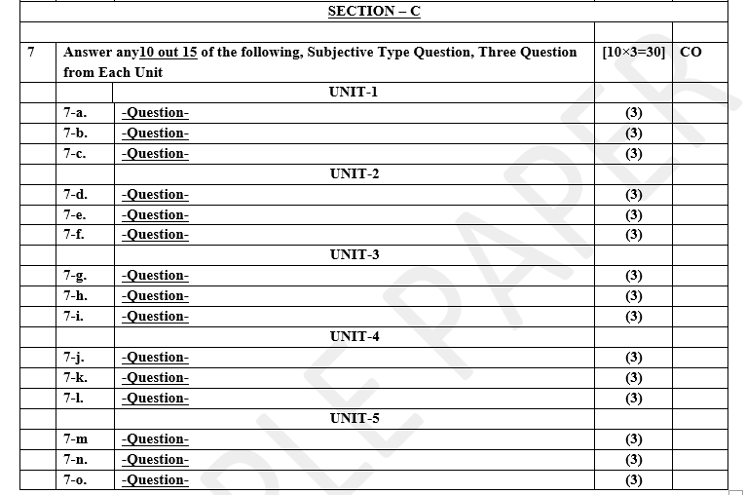
Pattern of Online External Exam Question Paper (100 marks)

Slide 24
Prerequisite / Recap
Student should have knowledge of object oriented analysis and design.
Knowledge of Data structure and algorithm.
knowledge of Programing language such as C/C++ etc.
Good problem solving Skill .

Slide 25
Brief Introduction about the Subject with videos
YouTube /other Video Links
https://youtu.be/rI4kdGLaUiQ?list=PL6n9fhu94yhUbctIoxoVTrklN3LMwTCmd
https://youtu.be/v9ejT8FO-7I?list=PLrhzvIcii6GNjpARdnO4ueTUAVR9eMBpc
https://youtu.be/VGLjQuEQgkI?list=PLt4nG7RVVk1h9lxOYSOGI9pcP3I5oblbx

Slide 26
Unit II Content
A Case Study: Designing a Document Editor.
Creational Patterns.
Abstract Factory.
Builder Factory Method,
Prototype Patterns.
Singleton Patterns.

Slide 27
Unit II Objective
In Unit II, the students will be able to find
What are Creational Patterns and their types in detail.
Learn the concept of Abstract Factory.
How Builder Factory Method works.
How and when we use Prototype Patterns.
Simplest and easiest pattern is Singleton Patterns how .

Slide 28
Topic Objective
Topic : A Case Study - Designing a Document Editor
This chapter presents a case study in the design of a “What-You-See-Is-What-You-Get” (or “WYSIWYG”) document editor called Lexi. We’ll see how design patterns capture solutions to design problems in Lexi and applications like it. By the end of this chapter you will have gained experience with eight patterns, learning them by example.

Slide 29
A Case Study - Designing a Document Editor
A WYSIWYG representation of the document occupies the large rectangular area in the center.
The document can mix text and graphics freely in a variety of formatting styles.
Surrounding the document are the usual pull-down menus and scroll bars, and a collection of page icons for jumping to a particular page in the document.

Slide 30
A Case Study - Designing a Document Editor
Design Problems
Seven problems in Lexis's design:-
Document Structure:
The choice of internal representation for the document affects nearly every aspect of Lexis's design.
All editing, formatting, displaying, and textual analysis will require traversing the representation.
The way we organize those impacts design information.
2. Formatting:
How does Lexi actually arrange text and graphics into lines and columns?
What objects are responsible for carrying out different formatting policies?
How do these policies interact with the document’s internal representation?

Slide 31
A Case Study - Designing a Document Editor
Design Problems
3. Embellishing the user interface:
Lexis user interface include scroll bar, borders and drop shadows that decorate the WYSIWYG document interface.
Such trimmings are likely to change as Lexis user interface evolves.
4. Supporting multiple look-and-feel standards:
Lexi should adapt easily to different look-and-feel standards such as Modify and Presentation Manager (PM) without major modification.
5. Supporting multiple window systems:
Different look-and-feel standards are usually implemented on different window system.
Lexi’s design should be independent of the window system as possible.

Slide 32
A Case Study - Designing a Document Editor
Design Problems
User Operations:
User control Lexi through various interfaces, including buttons and pull-down menus.
The functionality beyond these interfaces is scattered throughout the objects in the application.
Spelling checking and Hyphenation (automated process of breaking words):
How does Lexi support analytical operations checking for misspelled words and determining hyphenation points?
How can we minimize the number of classes we have to modify to add a new analytical operation?

Slide 33
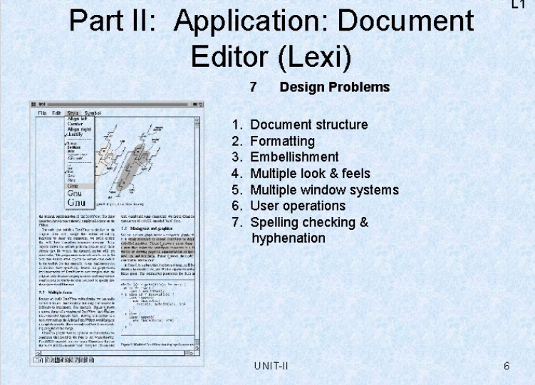
A Case Study - Designing a Document Editor

Slide 34
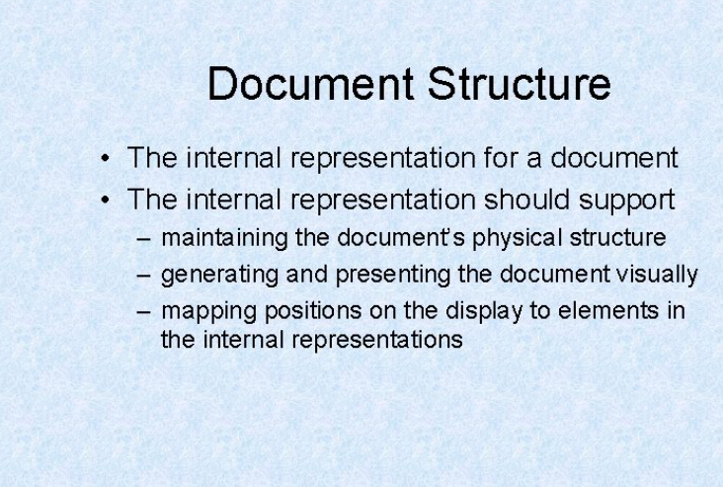
A Case Study - Designing a Document Editor

Slide 35
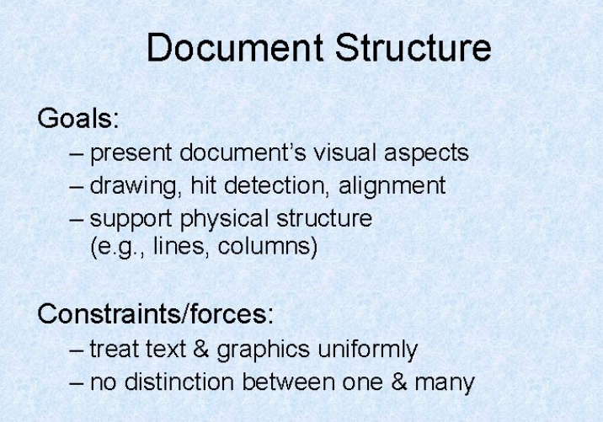
A Case Study - Designing a Document Editor

Slide 36
A Case Study - Designing a Document Editor
Document Structure
An arrangement of graphical elements (characters, lines, polygon, other shapes) and structural elements (lines, columns, figures, tables, and other substructures).
Lexi's user interface should let users manipulate these substructures directly. That helps make the interface simple.
For example, a user should be able to treat a diagram as a unit rather than as a collection of individual graphical primitives.
Goals
The internal representation should support:
Maintaining the document’s physical structure.
Generating and presenting the document’s visual aspects.
Mapping positions on the display to elements in the internal representations (drawing, hit detection, alignment, etc).

Slide 37
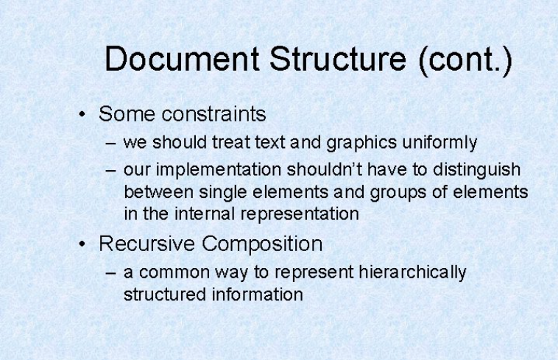
A Case Study - Designing a Document Editor

Slide 38
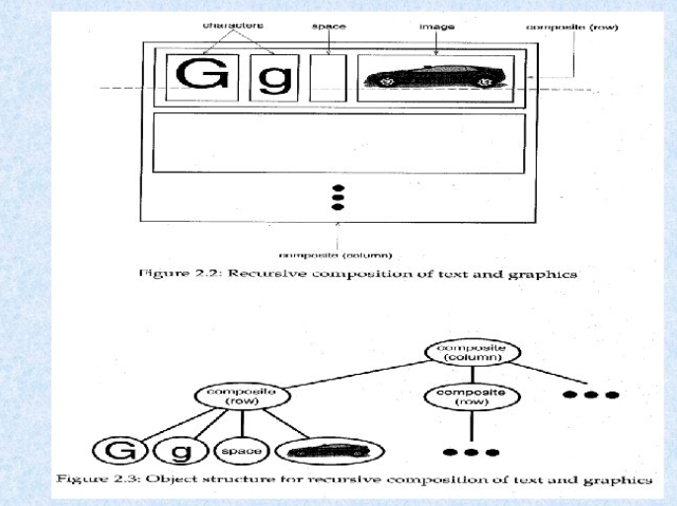
A Case Study - Designing a Document Editor

Slide 39
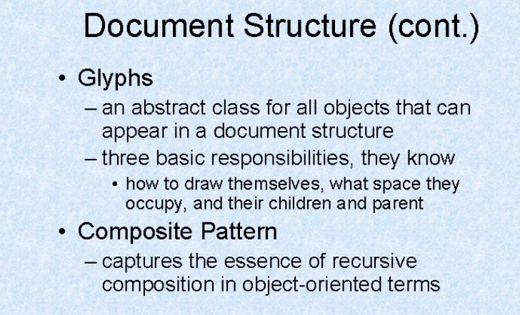
A Case Study - Designing a Document Editor

Slide 40
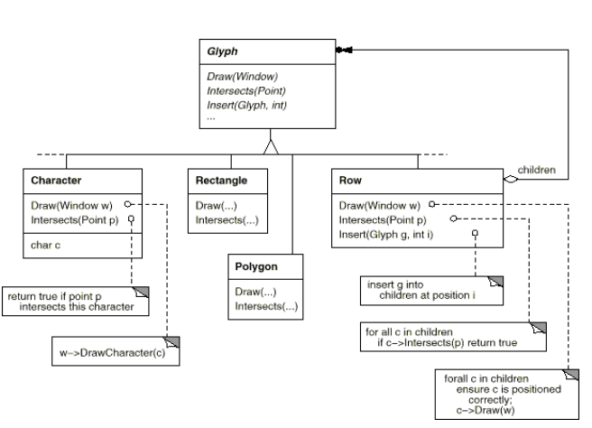
A Case Study - Designing a Document Editor

Slide 41
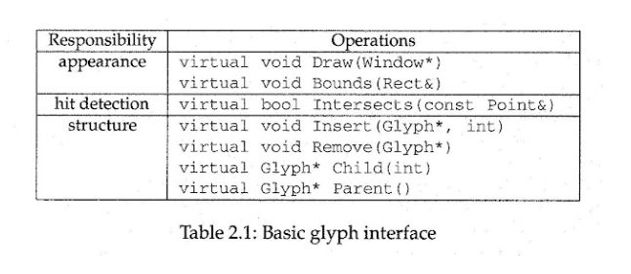
A Case Study - Designing a Document Editor

Slide 42
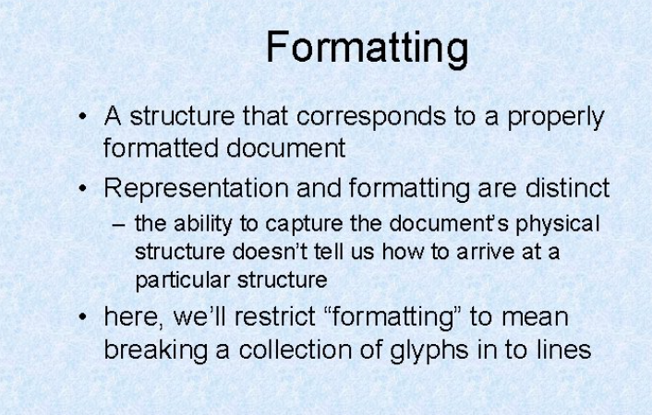
A Case Study - Designing a Document Editor

Slide 43
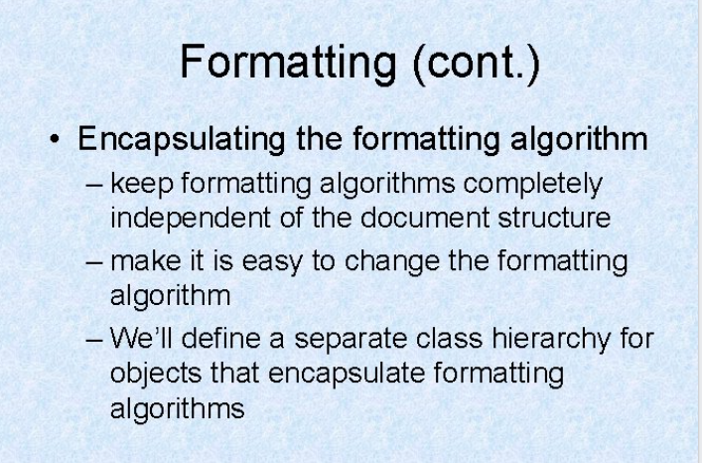
A Case Study - Designing a Document Editor

Slide 44
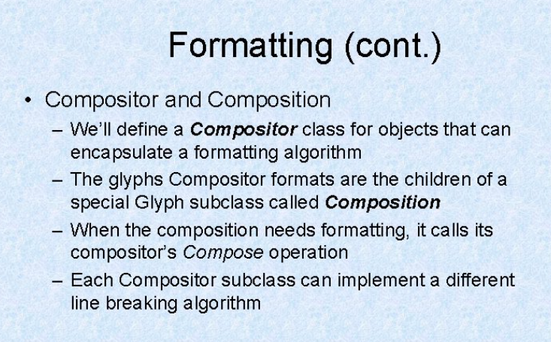
A Case Study - Designing a Document Editor

Slide 45
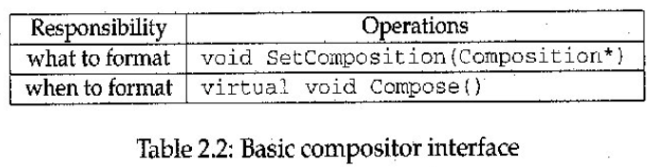
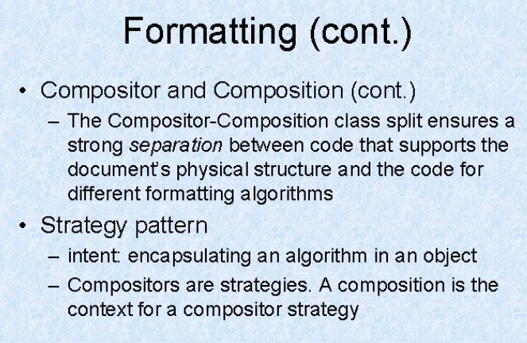
A Case Study - Designing a Document Editor

Slide 46
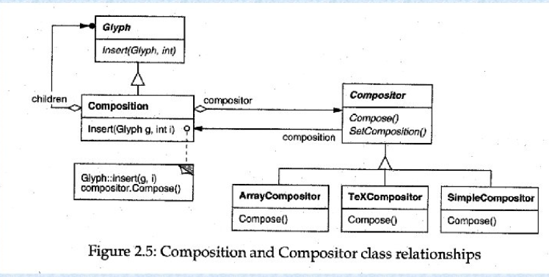
A Case Study - Designing a Document Editor

Slide 47
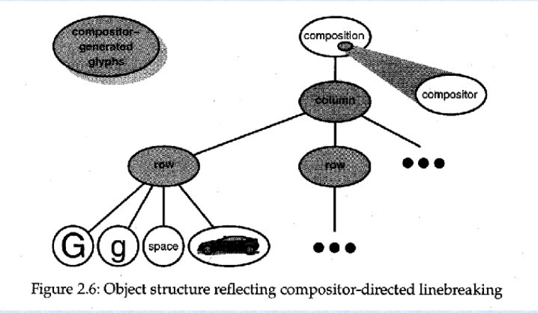
A Case Study - Designing a Document Editor

Slide 48
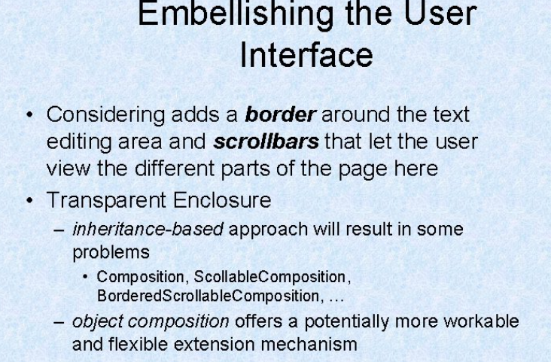
A Case Study - Designing a Document Editor

Slide 49
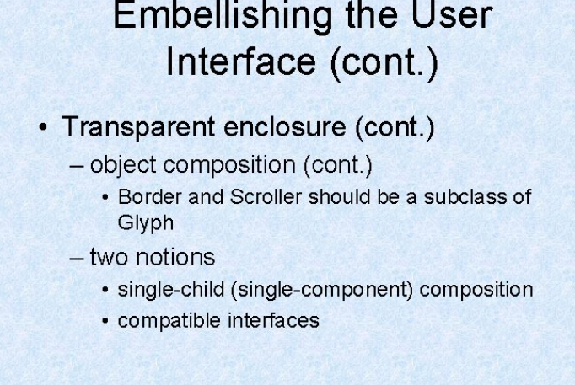
A Case Study - Designing a Document Editor

Slide 50
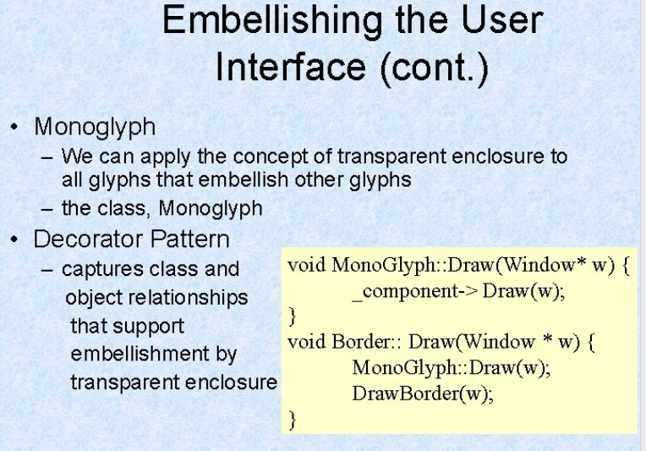
A Case Study - Designing a Document Editor

Slide 51
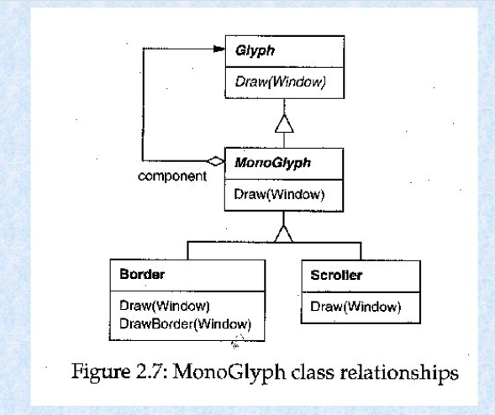
A Case Study - Designing a Document Editor

Slide 52
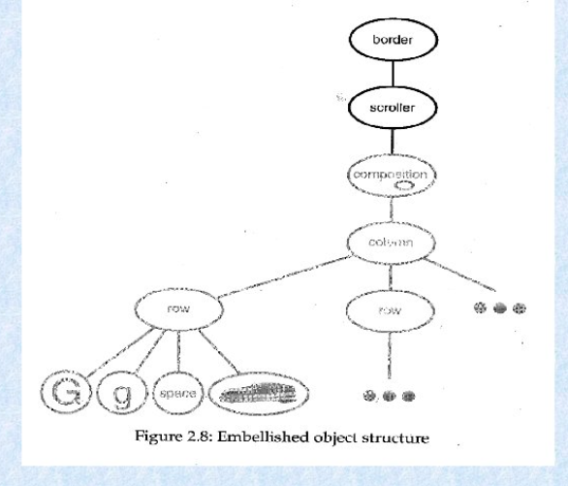
A Case Study - Designing a Document Editor

Slide 53
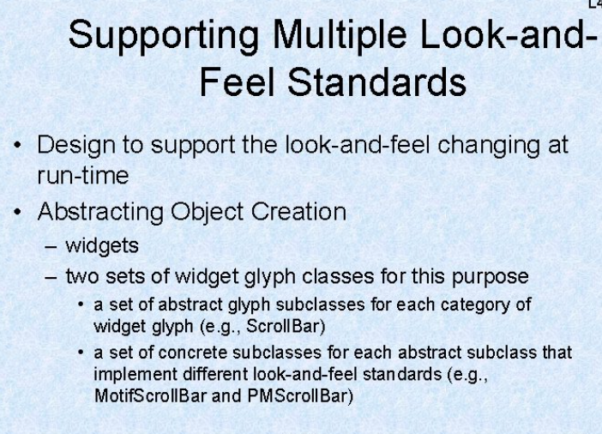
A Case Study - Designing a Document Editor

Slide 54
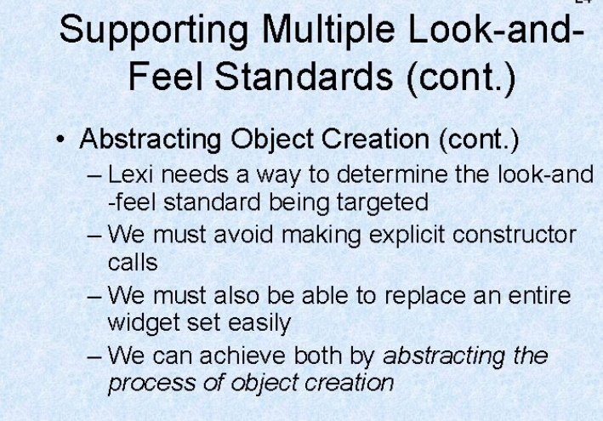
A Case Study - Designing a Document Editor

Slide 55
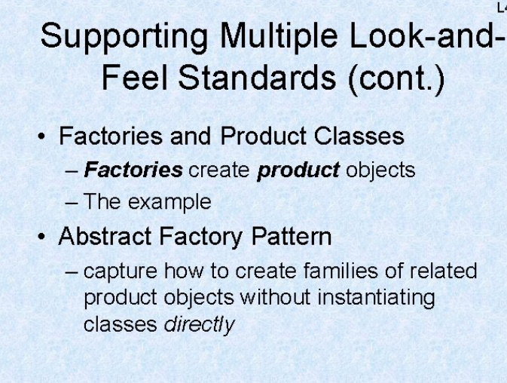
A Case Study - Designing a Document Editor

Slide 56
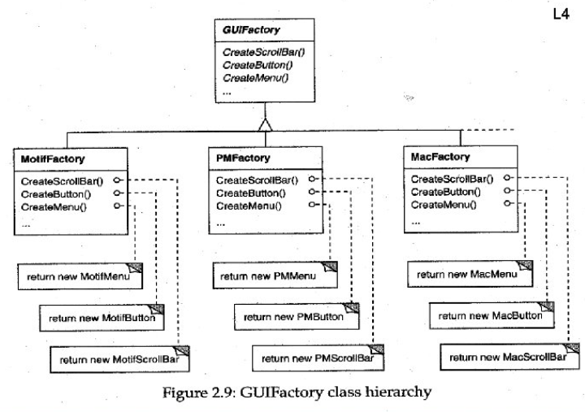
A Case Study - Designing a Document Editor

Slide 57
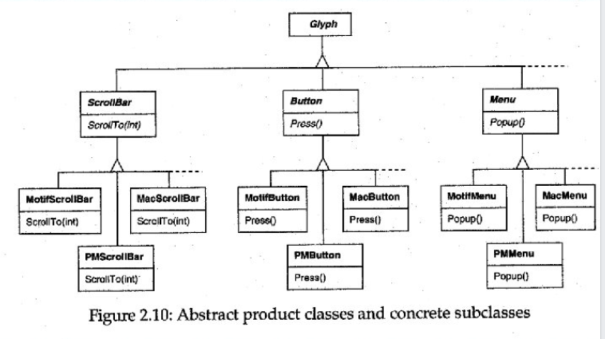
A Case Study - Designing a Document Editor

Slide 58
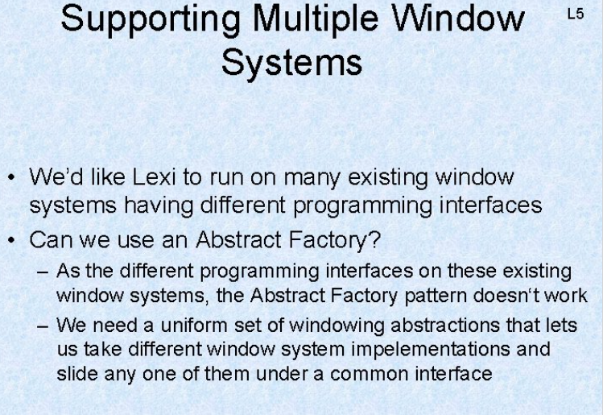
A Case Study - Designing a Document Editor

Slide 59
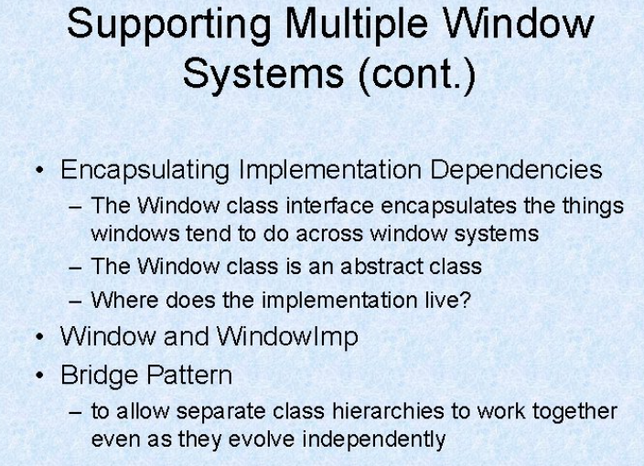
A Case Study - Designing a Document Editor

Slide 60
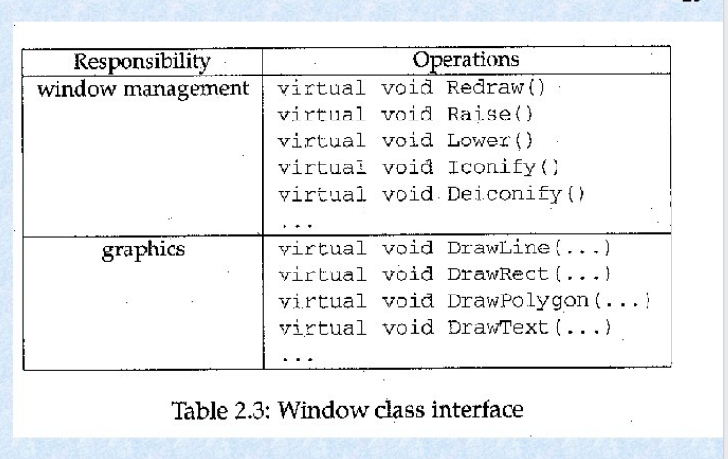
A Case Study - Designing a Document Editor

Slide 61
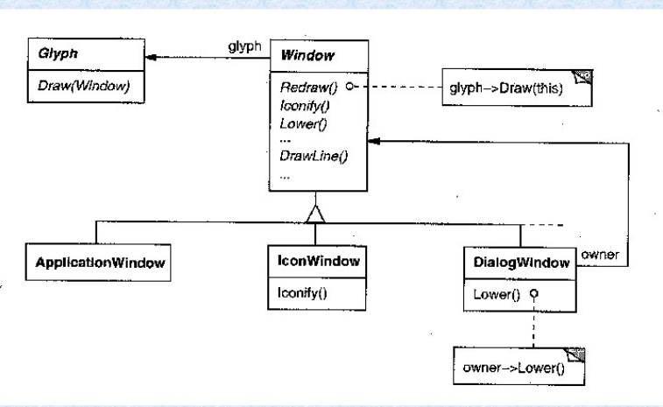
A Case Study - Designing a Document Editor

Slide 62
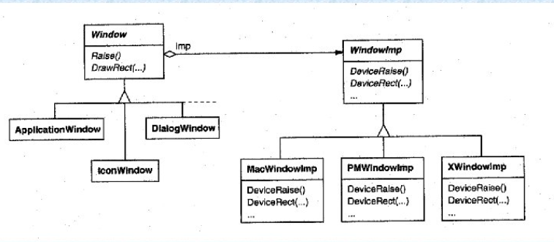
A Case Study - Designing a Document Editor

Slide 63
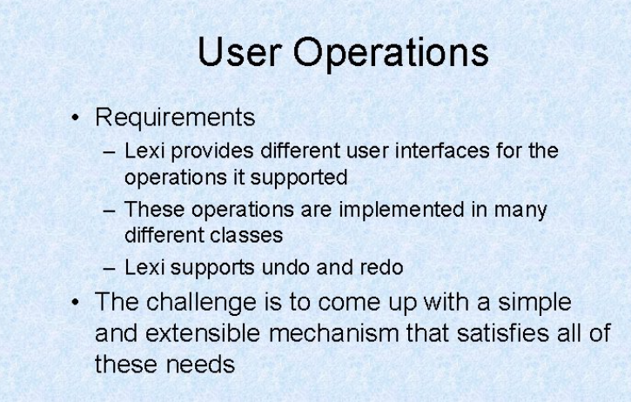
A Case Study - Designing a Document Editor

Slide 64
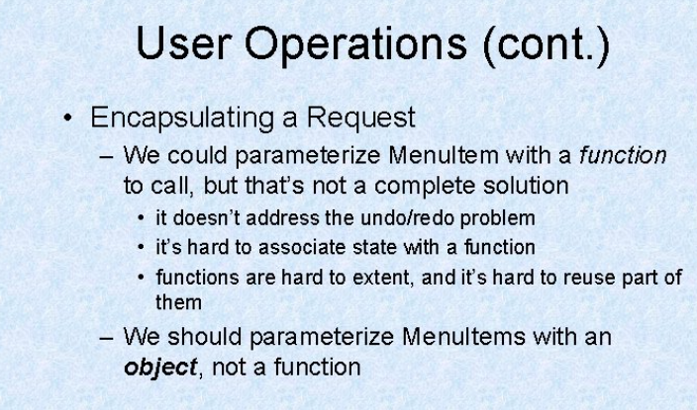
A Case Study - Designing a Document Editor

Slide 65
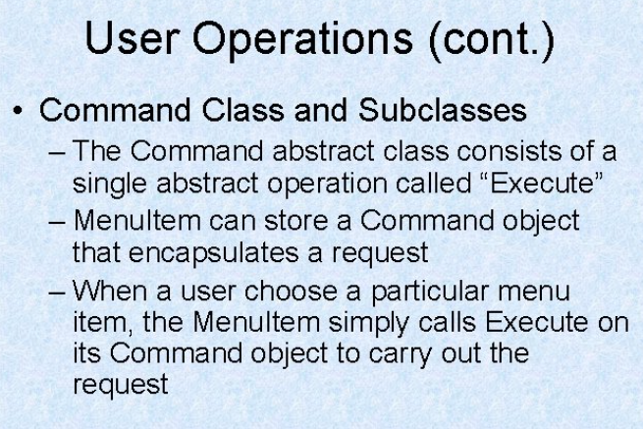
A Case Study - Designing a Document Editor

Slide 66
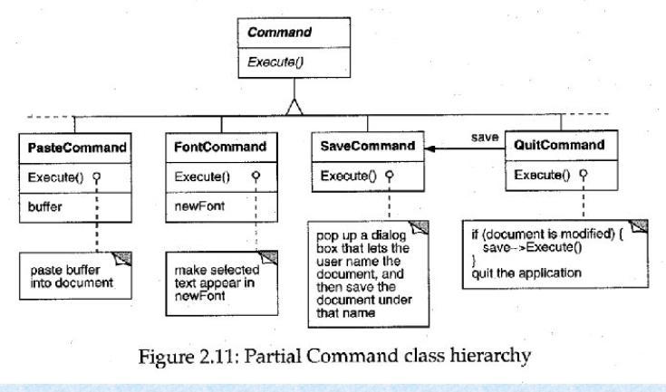
A Case Study - Designing a Document Editor

Slide 67
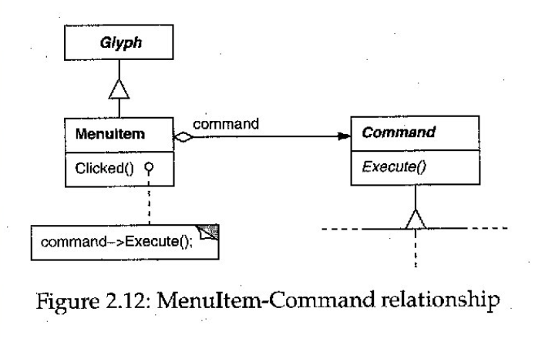
A Case Study - Designing a Document Editor

Slide 68
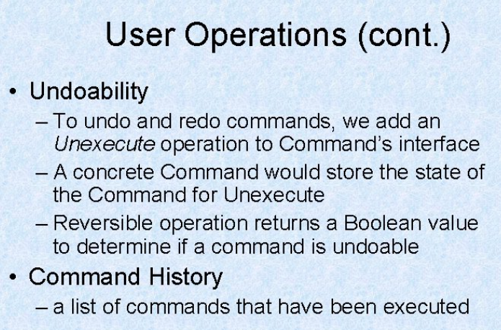
A Case Study - Designing a Document Editor

Slide 69
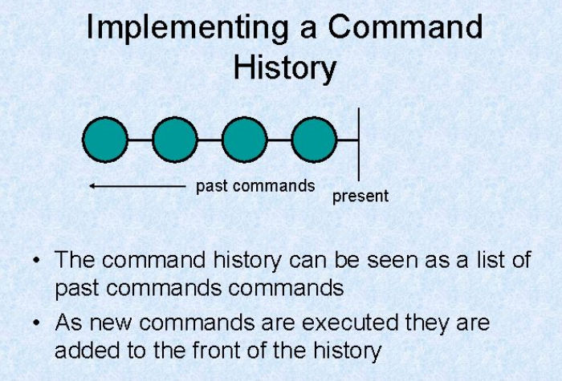
A Case Study - Designing a Document Editor

Slide 70
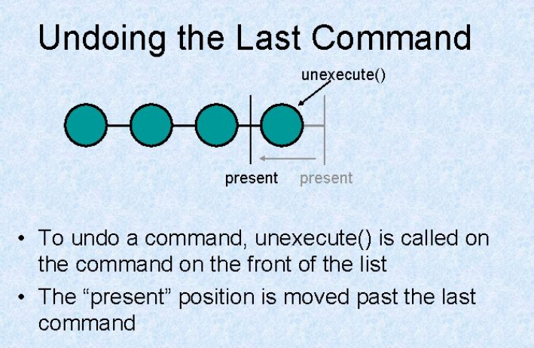
A Case Study - Designing a Document Editor

Slide 71
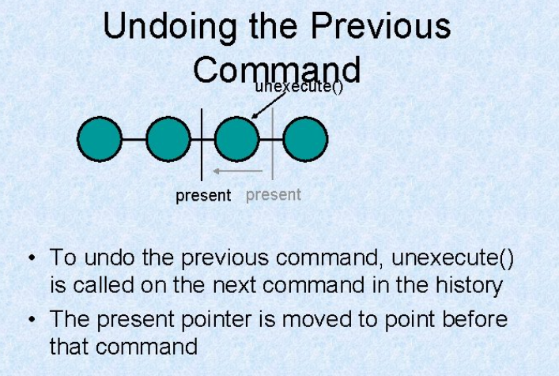
A Case Study - Designing a Document Editor

Slide 72
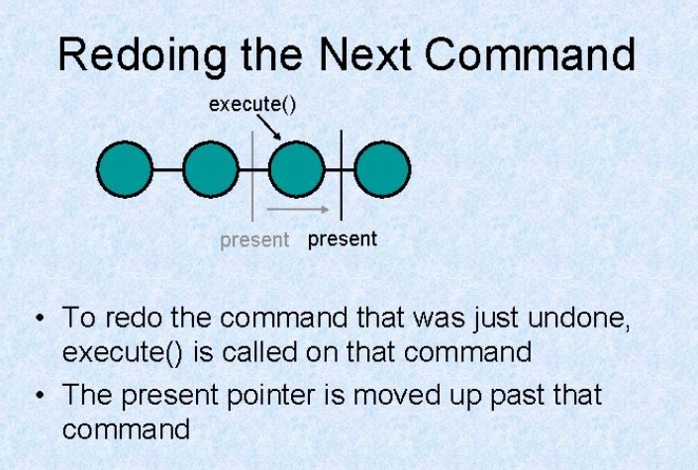
A Case Study - Designing a Document Editor

Slide 73
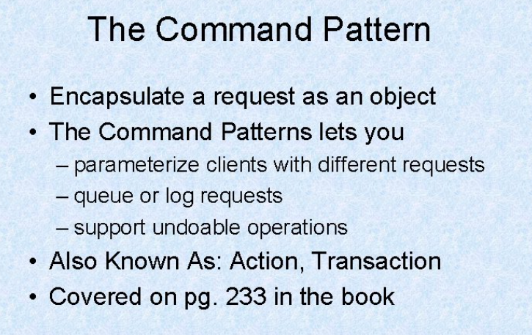
A Case Study - Designing a Document Editor

Slide 74
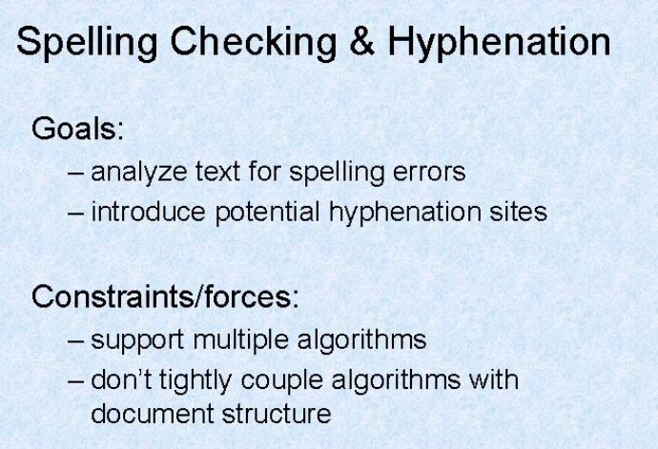
A Case Study - Designing a Document Editor

Slide 75
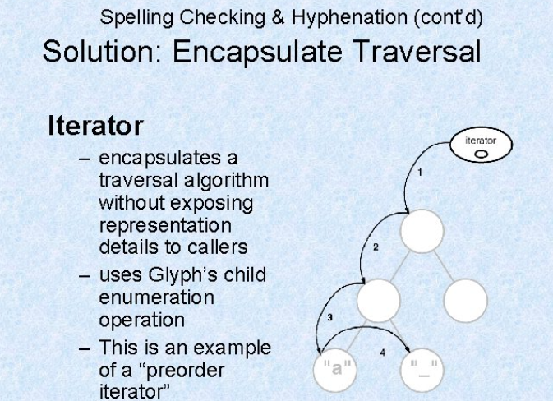
A Case Study - Designing a Document Editor

Slide 76
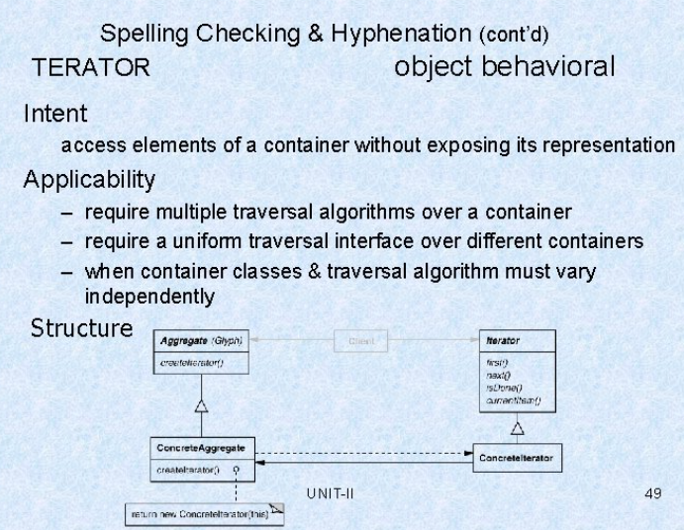
A Case Study - Designing a Document Editor

Slide 77

A Case Study - Designing a Document Editor

Slide 78

A Case Study - Designing a Document Editor

Slide 79

A Case Study - Designing a Document Editor

Slide 80

A Case Study - Designing a Document Editor

Slide 81

A Case Study - Designing a Document Editor

Slide 82

A Case Study - Designing a Document Editor

Slide 83

A Case Study - Designing a Document Editor

Slide 84

A Case Study - Designing a Document Editor

Slide 85

A Case Study - Designing a Document Editor

Slide 86

A Case Study - Designing a Document Editor

Slide 87

A Case Study - Designing a Document Editor

Slide 88
Topic Objective
Topic : Creational Patterns (Abstract Factory)
In this topic, the students will learn what are Creational Patterns that help in real world problem and what are abstract factory method and how Creates an instance of several families of classes.

Slide 89
Creational Patterns
Creational patterns:-
In software engineering, creational design patterns are design patterns that deal with object creation mechanisms, trying to create objects in a manner suitable to the situation. The basic form of object creation could result in design problems or added complexity to the design. Creational design patterns solve this problem by somehow controlling this object creation.
creational pattern provides one of the best ways to create an object.
Creational design patterns are concerned with the way of creating objects. These design patterns are used when a decision must be made at the time of instantiation of a class (i.e. creating an object of a class).

Slide 90
Abstract Factory Pattern
Abstract Factory patterns:-
Abstract Factory Pattern says that just define an interface or abstract class for creating families of related (or dependent) objects but without specifying their concrete sub-classes. That means Abstract Factory lets a class returns a factory of classes. So, this is the reason that Abstract Factory Pattern is one level higher than the Factory Pattern.
An Abstract Factory Pattern is also known as Kit.

Slide 91
Abstract Factory Pattern
Advantage of Abstract Factory Pattern:-
Abstract Factory Pattern isolates the client code from concrete (implementation) classes.
It eases the exchanging of object families.
It promotes consistency among objects.
Usage of Abstract Factory Pattern:-
When the system needs to be independent of how its object are created, composed, and represented.
When the family of related objects has to be used together, then this constraint needs to be enforced.
When you want to provide a library of objects that does not show implementations and only reveals interfaces.

Slide 92

UML\Structure for Abstract Factory Pattern

Slide 93
Implementation
We are going to create a Shape interface and a concrete class implementing it. We create an abstract factory class AbstractFactory as next step. Factory class ShapeFactory is defined, which extends AbstractFactory. A factory creator/generator class FactoryProducer is created.
AbstractFactoryPatternDemo, our demo class uses FactoryProducer to get a AbstractFactory object. It will pass information (CIRCLE / RECTANGLE / SQUARE for Shape) to AbstractFactory to get the type of object it needs.

Slide 94

Implementation of Abstract Factory Pattern
Step 1
Create an interface for Shapes.
(Shape.java)

Slide 95

Implementation of Abstract Factory Pattern
Step 2
Create concrete classes implementing the same interface.
(RoundedRectangle.java)

Slide 96


Implementation of Abstract Factory Pattern
Step 2 CONT…….
(RoundedSquare.java)
(Rectangle.java)

Slide 97

Implementation of Abstract Factory Pattern
Step 3
Create an Abstract class to get factories for Normal and Rounded Shape Objects.
AbstractFactory.java

Slide 98

Implementation of Abstract Factory Pattern
Step 4
Create Factory classes extending AbstractFactory to generate object of concrete class based on given information.
(ShapeFactory.java)

Slide 99

Implementation of Abstract Factory Pattern
Step 4
(RoundedShapeFactory.java)

Slide 100

Implementation of Abstract Factory Pattern
Step 5
Create a Factory generator/producer class to get factories by passing an information such as Shape
(FactoryProducer.java)

Slide 101

Implementation of Abstract Factory Pattern
Step 6
Use the FactoryProducer to get AbstractFactory in order to get factories of concrete classes by passing an information such as type.
(AbstractFactoryPatternDemo.java)

Slide 102

Implementation of Abstract Factory Pattern
Cont……

Slide 103

Implementation of Abstract Factory Pattern
Step 7

Slide 104
Topic Objective
Topic : Creational Patterns (Builder Design Pattern)
In this topic, the students will learn what are Creational Patterns that help in real world problem and what are Builder Design Pattern and how construct a complex object from simple objects using step-by-step approach.

Slide 105
Builder Design Pattern
Builder Design Pattern:-
Builder Pattern says that "construct a complex object from simple objects using step-by-step approach“.
It is mostly used when object can't be created in single step like in the
de-serialization of a complex object.
Advantage of Builder Design Pattern:-
The main advantages of Builder Pattern are as follows:
It provides clear separation between the construction and representation of an object.
It provides better control over construction process.
It supports to change the internal representation of objects.

Slide 106

UML\Structure for Builder Design Pattern

Slide 107
Implementation
We have considered a business case of fast-food restaurant where a typical meal could be a burger and a cold drink. Burger could be either a Veg Burger or Chicken Burger and will be packed by a wrapper. Cold drink could be either a coke or Pepsi and will be packed in a bottle.
We are going to create an Item interface representing food items such as burgers and cold drinks and concrete classes implementing the Item interface and a Packing interface representing packaging of food items and concrete classes implementing the Packing interface as burger would be packed in wrapper and cold drink would be packed as bottle.
We then create a Meal class having ArrayList of Item and a MealBuilder to build different types of Meal objects by combining Item. BuilderPatternDemo, our demo class will use MealBuilder to build a Meal.

Slide 108

Implementation of Builder Design Pattern

Slide 109


Implementation of Builder Design Pattern

Slide 110


Implementation of Builder Design Pattern

Slide 111


Implementation of Builder Design Pattern

Slide 112


Implementation of Builder Design Pattern

Slide 113


Implementation of Builder Design Pattern

Slide 114

Implementation of Builder Design Pattern

Slide 115
Topic Objective
Topic : Creational Patterns (Factory Design Pattern)
In this topic, the students will learn what are Creational Patterns that help in real world problem and what are Factory Pattern and how to define an interface or abstract class for creating an object but let the subclasses decide which class to instantiate.

Slide 116
Factory Design Pattern
Factory Design Pattern:-
A Factory Pattern or Factory Method Pattern says that just define an interface or abstract class for creating an object but let the subclasses decide which class to instantiate. In other words, subclasses are responsible to create the instance of the class.
The Factory Method Pattern is also known as Virtual Constructor.
Advantage of Factory Design Pattern:-
Factory Method Pattern allows the sub-classes to choose the type of objects to create.
It promotes the loose-coupling by eliminating the need to bind application-specific classes into the code. That means the code interacts solely with the resultant interface or abstract class, so that it will work with any classes that implement that interface or that extends that abstract class.

Slide 117
Factory Design Pattern
Usage of Factory Design Pattern:-
When a class doesn't know what sub-classes will be required to create.
When a class wants that its sub-classes specify the objects to be created.
When the parent classes choose the creation of objects to its sub-classes.
Factory pattern is one of the most used design patterns in Java. This type of design pattern comes under creational pattern as this pattern provides one of the best ways to create an object.
In Factory pattern, we create object without exposing the creation logic to the client and refer to newly created object using a common interface.

Slide 118

UML\Structure for Factory Design Pattern

Slide 119


Implementation
We're going to create a Shape interface and concrete classes implementing the Shape interface. A factory class ShapeFactory is defined as a next step.
FactoryPatternDemo, our demo class will use ShapeFactory to get a Shape object. It will pass information (CIRCLE / RECTANGLE / SQUARE) to ShapeFactory to get the type of object it needs.

Slide 120



Implementation

Slide 121


Implementation

Slide 122


Implementation

Slide 123

Implementation

Slide 124
Topic Objective
Topic : Creational Patterns (Prototype Design Pattern)
In this topic, the students will learn what are Creational Patterns that help in real world problem and what are Prototype Pattern and how to cloning of an existing object instead of creating new one and can also be customized as per the requirement.

Slide 125
Prototype Design Pattern
Prototype Design Pattern:-
Prototype Pattern says that cloning of an existing object instead of creating new one and can also be customized as per the requirement.
This pattern should be followed, if the cost of creating a new object is expensive and resource intensive.
Advantage of Prototype Design Pattern:-
The main advantages of prototype pattern are as follows:
It reduces the need of sub-classing.
It hides complexities of creating objects.
The clients can get new objects without knowing which type of object it will be.
It lets you add or remove objects at runtime.

Slide 126


Slide 127




Slide 128
Prototype Design Pattern
Usage of Prototype Design Pattern:-
When the classes are instantiated at runtime.
When the cost of creating an object is expensive or complicated.
When you want to keep the number of classes in an application minimum.
When the client application needs to be unaware of object creation and representation.
This pattern is used when creation of object directly is costly. For example, an object is to be created after a costly database operation. We can cache the object, returns its clone on next request and update the database as and when needed thus reducing database calls.

Slide 129

UML\Structure for Prototype Design Pattern

Slide 130
Implementation of Prototype Design Pattern
Prototype pattern refers to creating duplicate object while keeping performance in mind. This type of design pattern comes under creational pattern as this pattern provides one of the best ways to create an object.
This pattern involves implementing a prototype interface which tells to create a clone of the current object.
We're going to create an abstract class Shape and concrete classes extending the Shape class. A class ShapeCache is defined as a next step which stores shape objects in a Hashtable and returns their clone when requested.
PrototypPatternDemo, our demo class will use ShapeCache class to get a Shape object.

Slide 131


Implementation of Prototype Design Pattern

Slide 132


Implementation of Prototype Design Pattern

Slide 133

Implementation of Prototype Design Pattern

Slide 134

Implementation of Prototype Design Pattern

Slide 135

Implementation of Prototype Design Pattern

Slide 136

Implementation of Prototype Design Pattern

Slide 137

Implementation of Prototype Design Pattern

Slide 138
Topic Objective
Topic : Creational Patterns (Singleton Design Pattern)
In this topic, the students will learn what are Creational Patterns that help in real world problem and what are Singleton Pattern and how a Singleton Pattern says that just "define a class that has only one instance and provides a global point of access to it".

Slide 139
Singleton Design Patterns
Singleton Design patterns:-
Singleton Pattern says that just“ define a class that has only one instance and provides a global point of access to it".
In other words, a class must ensure that only single instance should be created and single object can be used by all other classes.
There are two forms of singleton design pattern:-
Early Instantiation: creation of instance at load time.
Lazy Instantiation: creation of instance when required.

Slide 140
Singleton Design Pattern
Advantage of Singleton Design Pattern:-
Saves memory because object is not created at each request. Only single instance is reused again and again.
Usage of Singleton design pattern :-
Singleton pattern is mostly used in multi-threaded and database applications. It is used in logging, caching, thread pools, configuration settings etc.

Slide 141
Singleton Design Pattern
How to create Singleton design pattern:-
To create the singleton class, we need to have static member of class, private constructor and static factory method.
Static member: It gets memory only once because of static, it contains the instance of the Singleton class.
Private constructor: It will prevent to instantiate the Singleton class from outside the class.
Static factory method: This provides the global point of access to the Singleton object and returns the instance to the caller.

Slide 142
Implementation
Singleton pattern is one of the simplest design patterns in Java. This type of design pattern comes under creational pattern as this pattern provides one of the best ways to create an object.
We're going to create a SingleObject class. SingleObject class have its constructor as private and have a static instance of itself.
SingleObject class provides a static method to get its static instance to outside world. SingletonPatternDemo, our demo class will use SingleObject class to get a SingleObject object.

Slide 143

UML\Structure for Singleton Design Pattern

Slide 144


Implementation of Singleton Design Pattern

Slide 145



Implementation of Singleton Design Pattern

Slide 146
Daily Quiz
Which of the following pattern refers to creating duplicate object while keeping performance in mind.
Builder Pattern
Bridge Pattern
Prototype Pattern
Filter Pattern.
Define the skeleton of an algorithm in an operation, deferring some steps to subclasses. It lets subclasses redefine certain steps of an algorithm without changing the algorithm structure.
Chain of responsibility
Template method
Interpreter
Prototype

Slide 147
Daily Quiz
Which design pattern suggest multiple classes through which request is passed and multiple but only relevant classes carry out operations on the request.
Singleton pattern
Chain of responsibility pattern
State pattern
Bridge pattern
Most user interface design patterns fall with in one of ____ categories of patterns.
5
10
25
100

Slide 148
Weekly Assignment
What are Design Patterns in Java? What are the types of design patterns in Java.
What are the Creational Patterns and What Is Factory Pattern.
What Is Abstract Factory Pattern.
Explain Structural Patterns in Java.
5. Explain the Singleton pattern.

Slide 149
Topic Link ( YouTube & NPTEL Video Links)
YouTube /other Video Links
https://youtu.be/rI4kdGLaUiQ?list=PL6n9fhu94yhUbctIoxoVTrklN3LMwTCmd
https://youtu.be/v9ejT8FO-7I?list=PLrhzvIcii6GNjpARdnO4ueTUAVR9eMBpc
https://youtu.be/VGLjQuEQgkI?list=PLt4nG7RVVk1h9lxOYSOGI9pcP3I5oblbx

Slide 150
MCQ (End of Unit)
1. Design patterns can be classified in _______ categories.
1
2
3
4
2. Which design patterns are specifically concerned with communication between objects?
Creational Patterns
Structural Patterns
Behavioral Patterns
J2EE Patterns

Slide 151
MCQ (End of Unit)
3. Which design pattern provides a single class which provides simplified methods required by client and delegates call to those methods?
Adapter pattern
Builder pattern
Facade pattern
Prototype pattern
4. Which design pattern suggests multiple classes through which request is passed and multiple but only relevant classes carry out operations on the request?
Singleton pattern
Chain of responsibility pattern
State pattern
Bridge pattern

Slide 152
Glossary Questions
Top 10 design pattern interview questions
What are design patterns?
How are design patterns categorized?
Explain the benefits of design patterns in Java.
Describe the factory pattern.
Differentiate ordinary and abstract factory design patterns.
What do you think are the advantages of builder design patterns?
How is the bridge pattern different from the adapter pattern?
What is a command pattern?
Describe the singleton pattern along with its advantages and disadvantages.
What are anti patterns?

Slide 153
Expected Questions for University Exam
What are design patterns?
How are design patterns categorized?
Explain the benefits of design patterns in Java.
Describe the factory pattern.
Differentiate ordinary and abstract factory design patterns.
What do you think are the advantages of builder design patterns?
How is the bridge pattern different from the adapter pattern?
What is a command pattern?
Describe the singleton pattern along with its advantages and disadvantages.
What are anti patterns?

Slide 154
Recap of Unit
Till Now we understand, a case study in the design of a “What-You-See-Is-What-You-Get” (or “WYSIWYG”) document editor called Lexi. We’ll see how design patterns capture solutions to design problems in Lexi and applications like it.
By the end of this chapter you will have gained experience with eight patterns, learning them by example.
You also learn what are Creational Patterns that help in real world problem and what are abstract factory method and how Creates an instance of several families of classes.
what are Prototype Pattern and how to cloning of an existing object instead of creating new one and can also be customized as per the requirement.

